Slide 1






Estonian Safer Internet Center project Smartly on the Web
Notes:
1

Slide 2

Estonian Safer Internet Centre
Estonian Safer Internet Centre
Estonian Union for Child Welfare
Education and Youth Board
Tallinn University of Technology
Estonian Social Insurance Board
Project Targalt internetis – Smartly on the Web
Beginning in the fall of 2010.
Co-financed to the extent of 50% by the European Union.
Notes:
Estonian Safer Internet Centre is a consortium of four organisations to carry out a project Smartly on the Web.. Different types of organisations: the Estonian Union for Child Welfare is non-profit/non-governmental organisation, the Education and Youth Board and Social Insurance Board are governmental organisations and Tallinn University of Technology
The role of EUCW and other consortium members. EUCW: communication, coordination of joint activities, implementation of its own activities, communication of messages for public, policy makers, cooperation with AB members and other stakeholders.
2

Slide 3
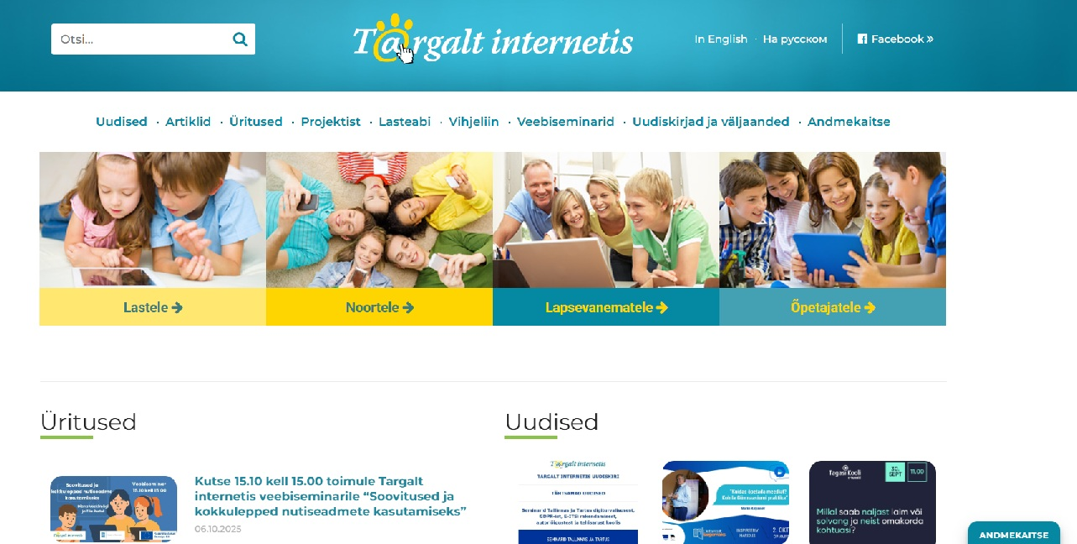
Estonian Safer Internet Centre
Three activity strands
promote digital competence of children,
parents, teachers and other relevant
professionals working with children;
provide counselling and support for children and parents via the Child Helpline 116111 in matters related to children's use of digital technology and services;
provide a hotline to receive reports from the public of potential child sexual abuse material (CSAM) on the Internet.
Main target groups are children, young people under 18, parents, caregivers and teachers
https://www.targaltinternetis.ee/
Notes:
3

Slide 4
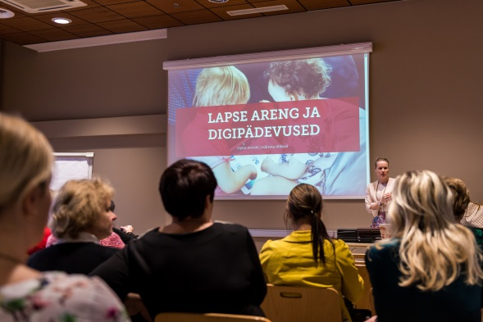
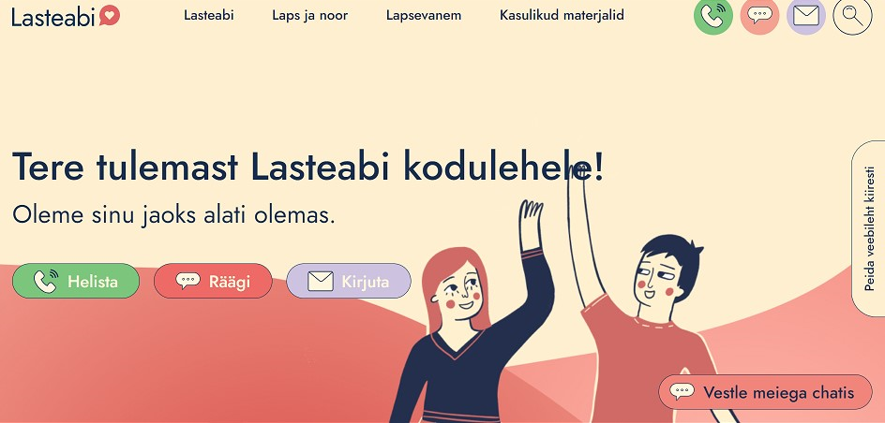

Estonian Safer Internet Centre
Awareness raising
www.targaltinternetis.ee
Education and Youth Board
Tallinn University of Technology
Estonian Union for Child Welfare
Social Insurance Board
Helpline – Child Helpline 116111
Social Insurance Board
Hotline
Estonian Union for
Child Welfare
4

Slide 5

Advisory Board
Ministry of Education and Research
Ministry of the Interior
Ministry of Social Affairs
Estonian Information System Authority
Estonian Data Protection Inspectorate
Police and Border Guard Board
Estonian Association of Parents,
Association of School Psychologists
Estonian Association of Informatics Teachers
Estonian Association of Information Technology and Telecommunications
University of Tartu
Chancellor of Justice Office
Telia Estonia
Elisa Estonia
Notes:
5

Slide 6
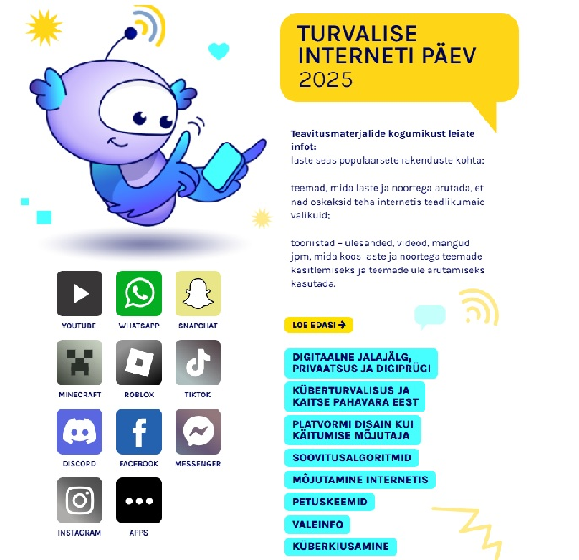

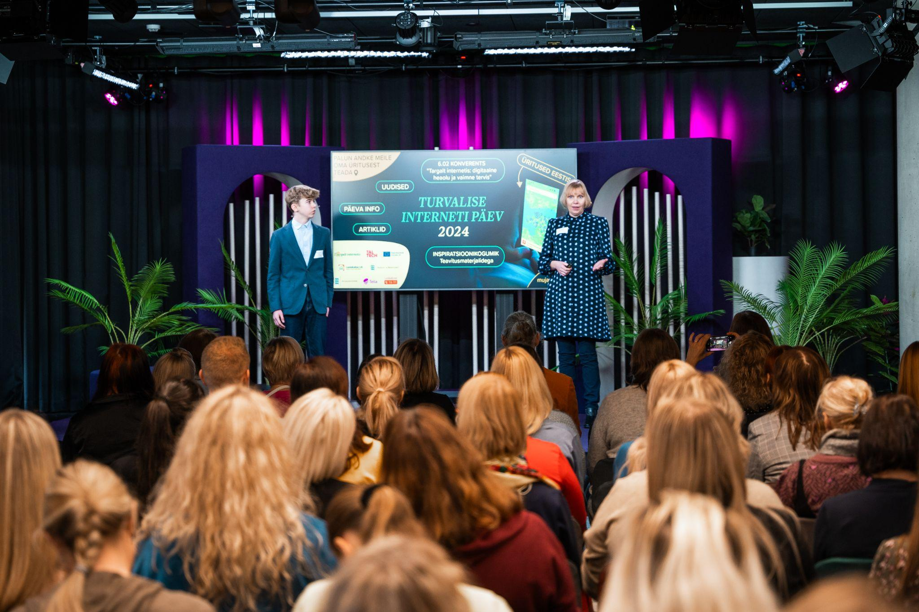
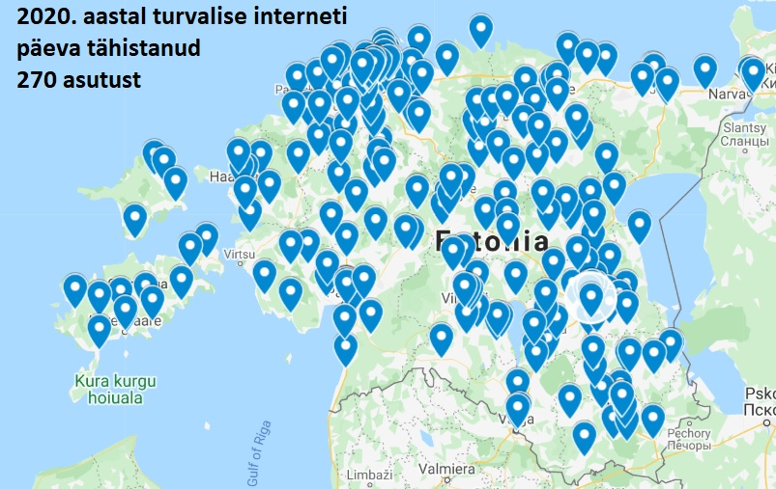
Awareness activities
Safer Internet Day campaigns and conferences
Awareness raising materials
Cooperation with schools, kindergartens etc
Conferences
Webinars
Articles in media, interviews
Notes:
2025 – dialogue between adults and children for healthy and safe use of internet and digital technology; 2024 digital wellbeing and mental health; 2023 – data protection- my data is my property; 2022 – communication and behaviour; 2021 – fake news and false information
6

Slide 7

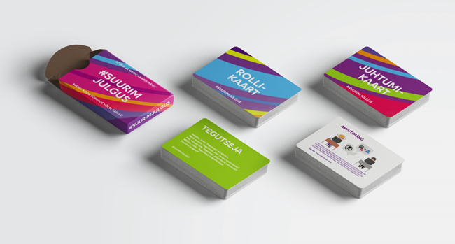

Awareness activities in cooperation with telecommunication companies
Telia Estonia
Campaign Suurim julgus – together against
cyberbullying
Board game Suurim julgus
Information materials for parents
Webinars for parents
Elisa Estonia
Campaign “Ole kaasas”
(Be aware and support your child's safe use
of internet) targeted to parents:
information material on screens
in Elisa’s sales offices, landing page
on the Estonian SIC website
press release, articles in media
Notes:
7

Slide 8

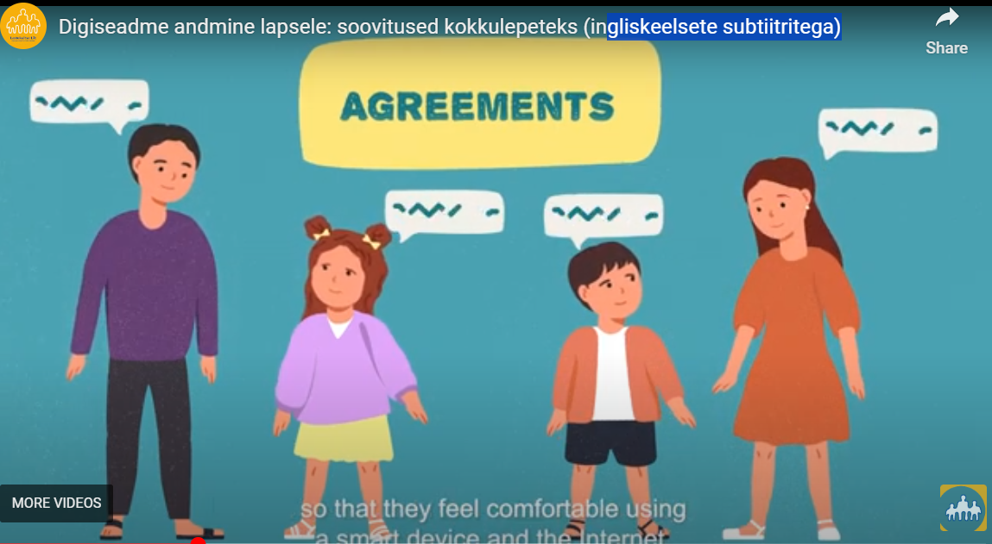
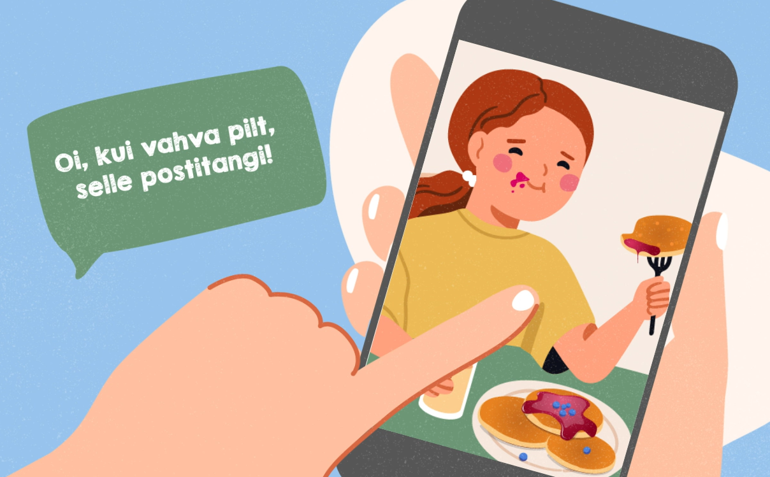
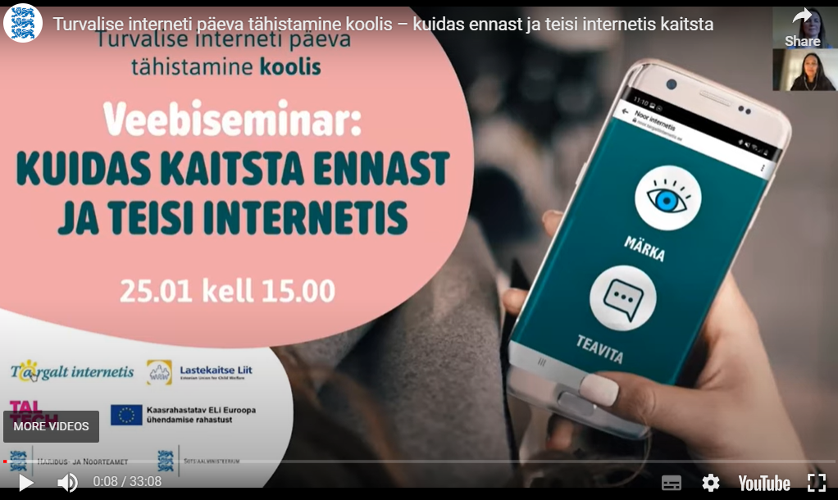
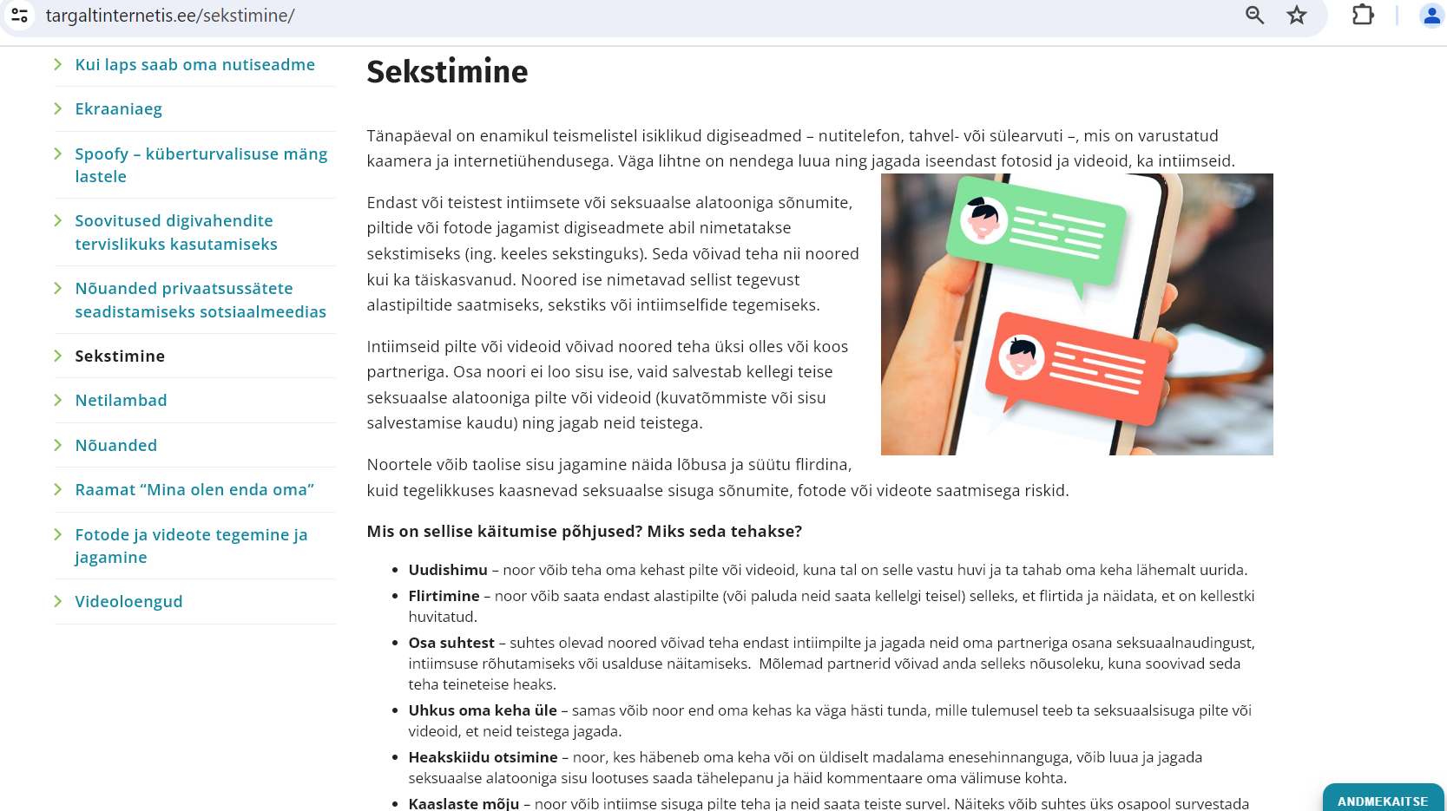

Awareness activities for parents
Webinars, podcasts
Awareness raising materials
Articles
Notes:
8

Slide 9
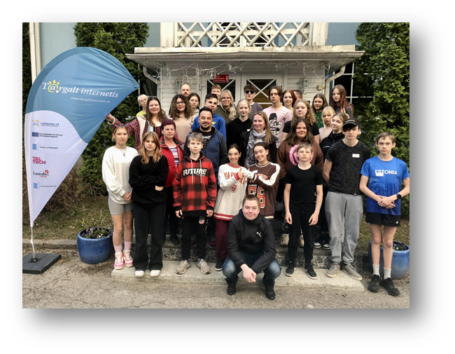
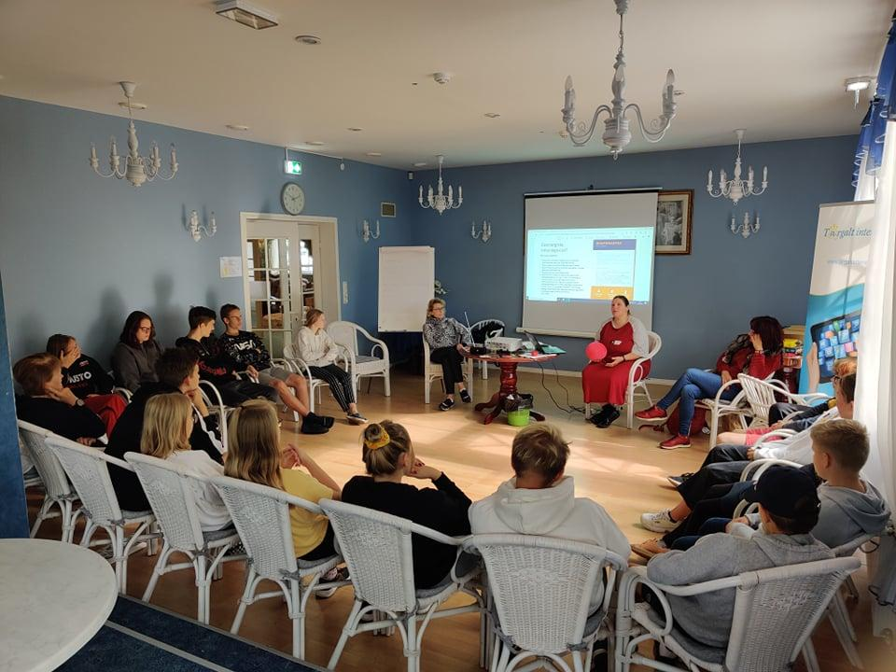
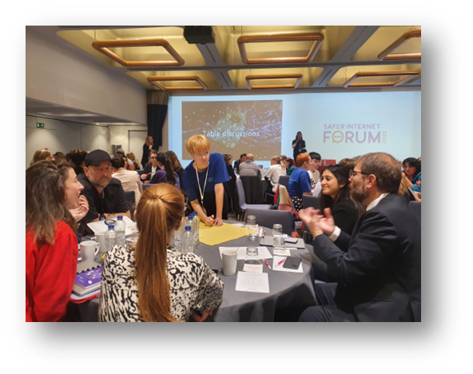
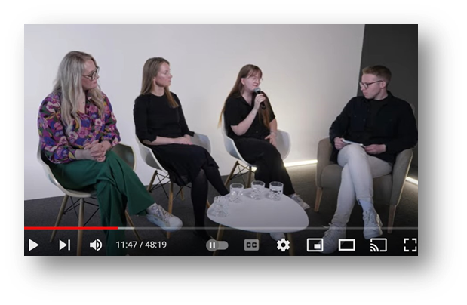
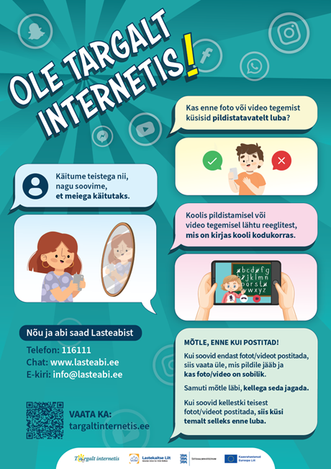

Cooperation with young people
Seminars
Workshops
Consultations
Youth initiatives
Participation in BIK Youth Panel
Notes:
Cooperation with young people to get their expertise, consulting us and contributes to the development of information materials for children, youth and parents. Multi-days seminars, workshops, etc.
9

Slide 10
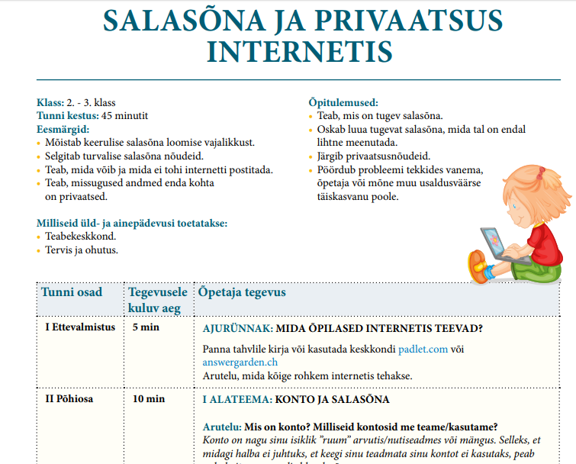
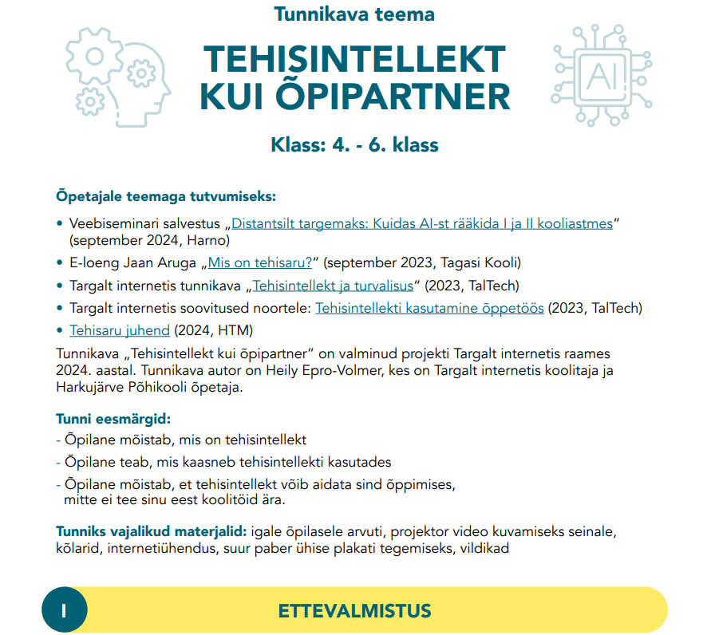
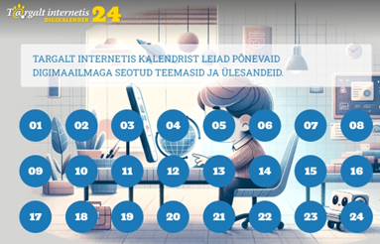
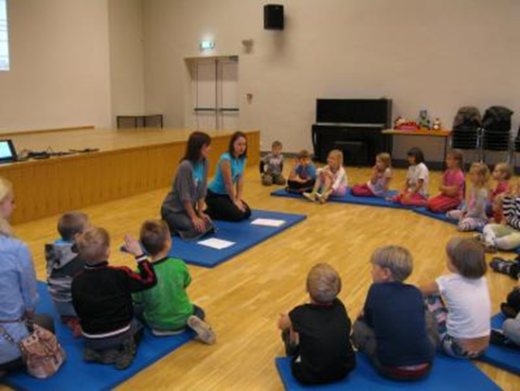
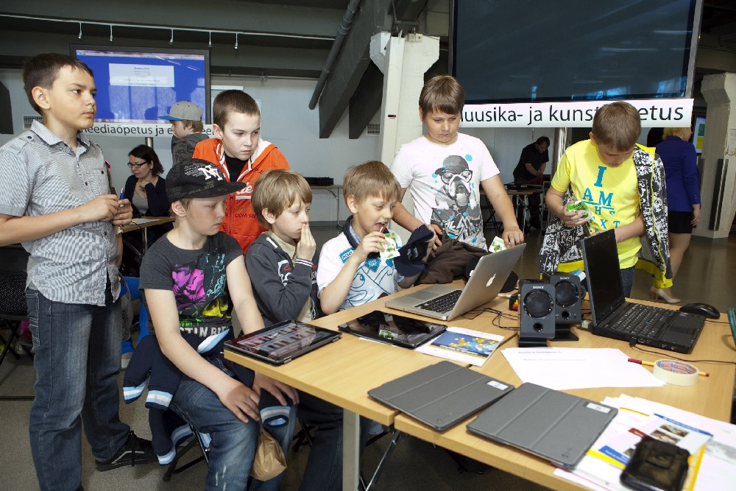
Cooperation with schools and kindergartens (EUCW)
Workshops for children and students
Lesson plans for teachers
Awareness raising materials for children
Notes:
10

Slide 11
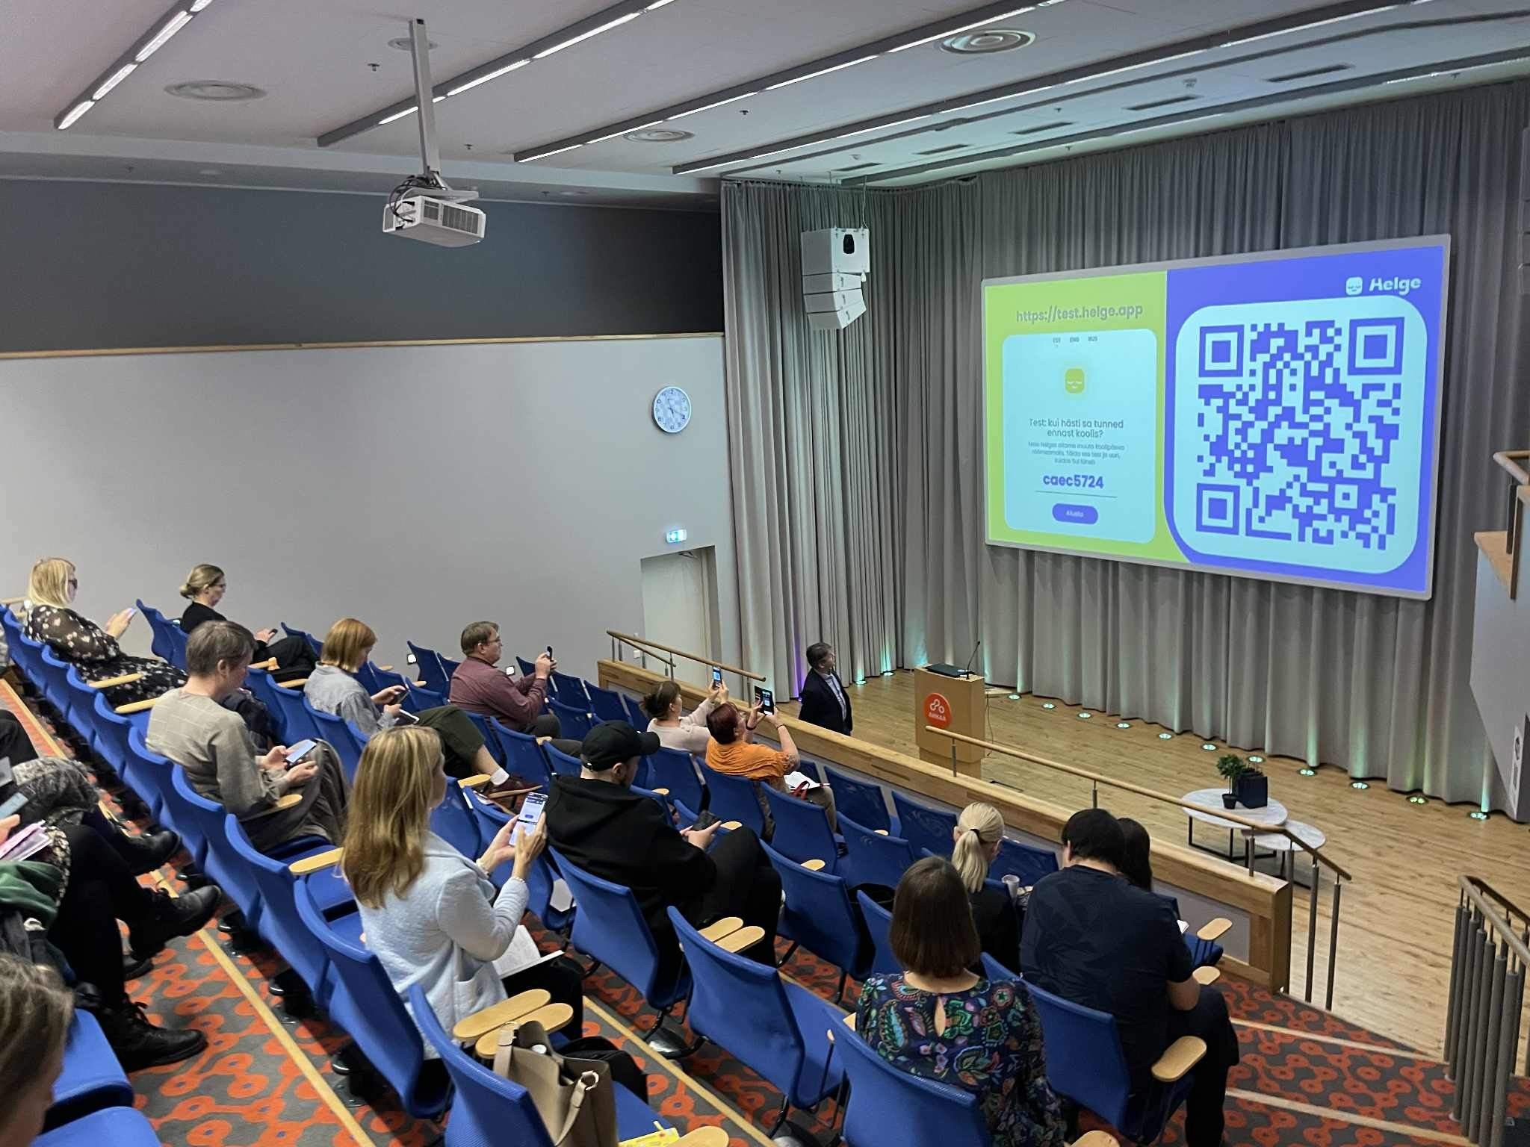
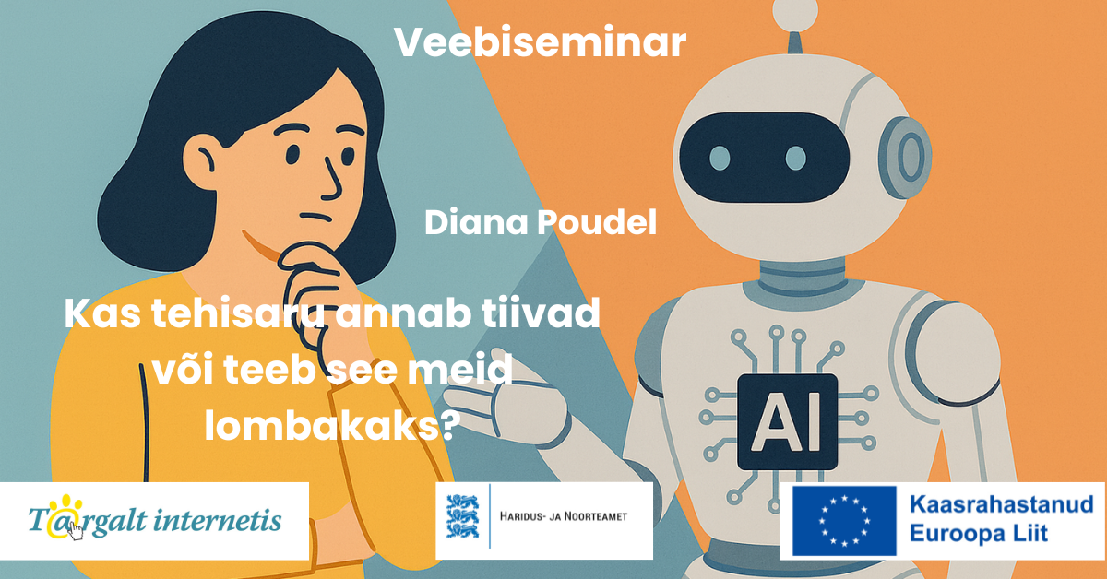
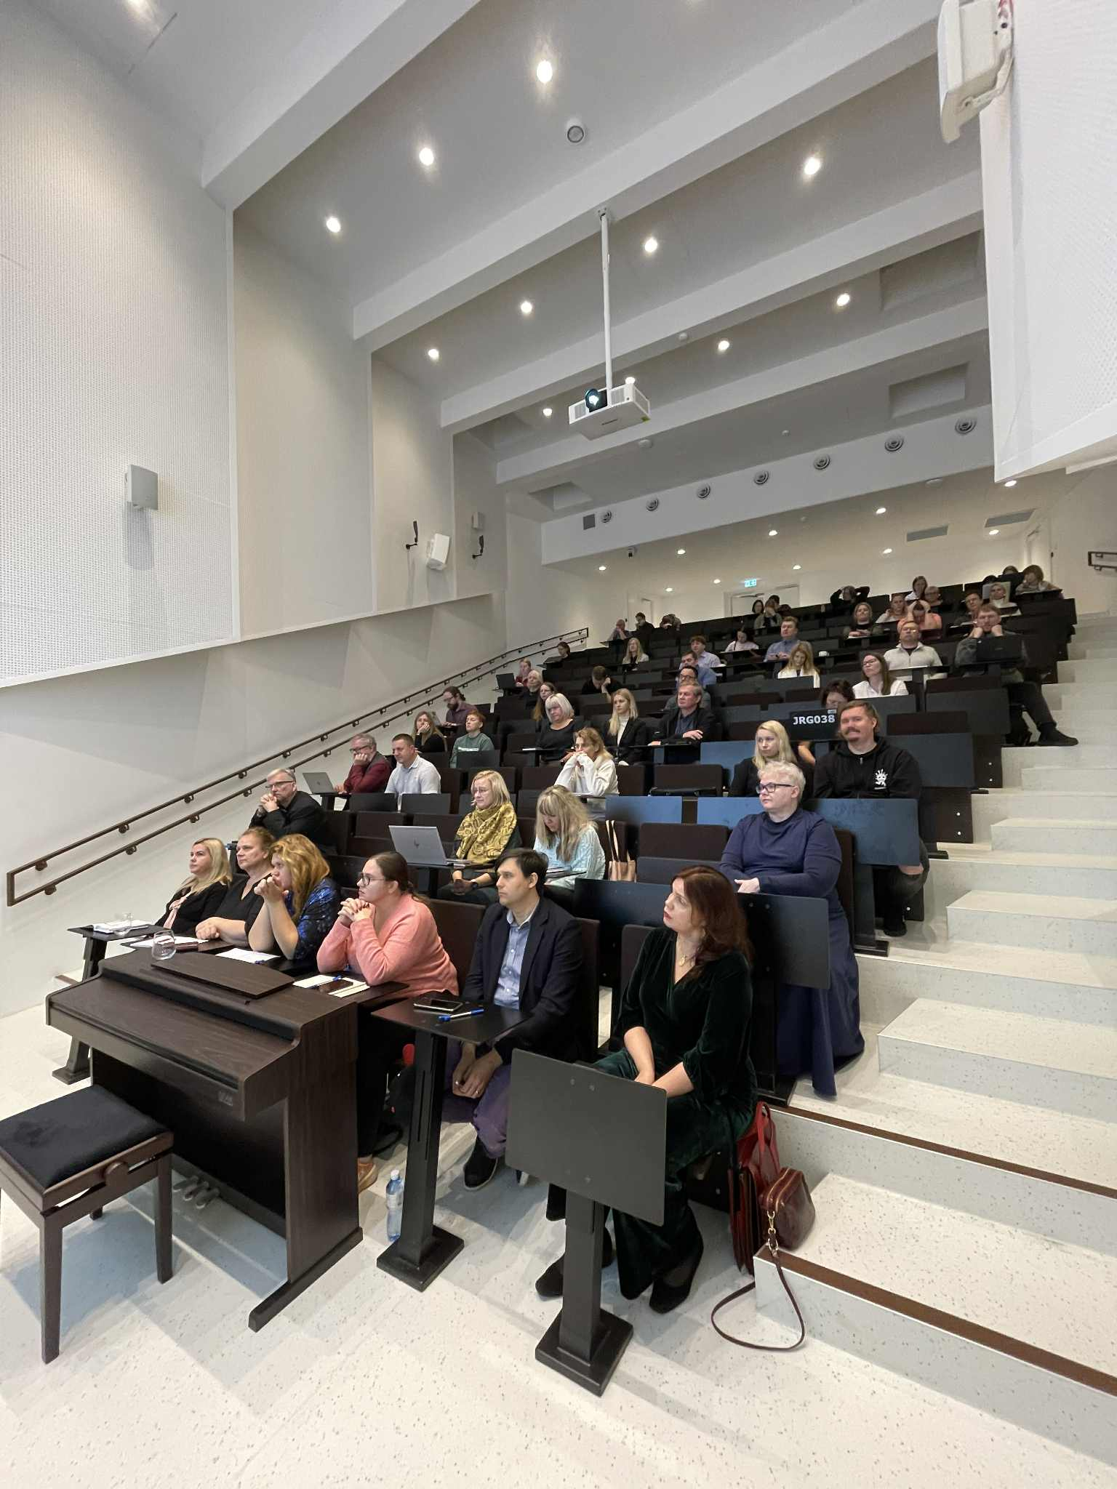

Cooperation with schools and kindergartens
Webinars for teachers
Development of e-courses and resources
Seminars for teachers and school/kindergarten
staff
Regular newsletters
11

Slide 12
Cooperation with schools
Cyber Competitions
CyberPin
Grades 1–6, 8,086 participants (50/50 boys–girls)
School lessons = key source of digital safety & AI knowledge AI mostly banned in class Girls’ IT interest falls with age; boys’ stays stable More focus needed on AI & cybersecurity in schools
CyberCracker
Grades 4–9, 8,022 students, 169 schools (Estonian 6,780 / Russian 1,242)
Main safety knowledge: school & clubs 66%, parents 61%, friends 40% Awareness: “Smartly on the Web” better known among Estonian students (65%) Child Helpline 116111 familiar to ~70% Estonian students AI use: Russian-speaking students use chatbots more; curious youth explore AI independently
12

Slide 13

Cooperation with schools
Teacher guidance: Estonian 54–65% (“don’t use”), 41–62% (“how to use”); Russian much lower Future demand: 50–63% want AI programming lessons Trend: Privacy awareness grows with age
CyberDrill
Competition for grades 7–12 & vocational schools,
3,826 participants (75 schools) → Finals: 124 teams / 450 students
Teacher info: 72% Estonian, 61% Russian
Russian vocational students: highest self-confidence (36%)
AI: explored occasionally, interest grows with age; ~⅓ use in studies
Schools stress limits > practical use of AI
More focus needed on data safety & cyberbullying
The Exercises portal
Good practices and guidelines for service providers and schools.
13
Notes:
(https://ylesanded.targaltinternetis.ee/)

Slide 14

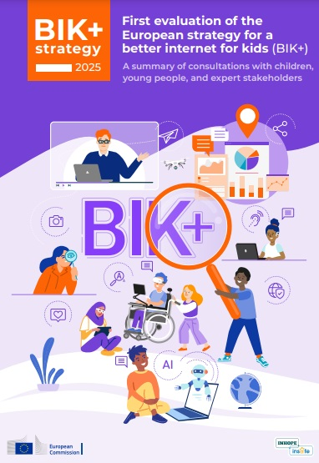
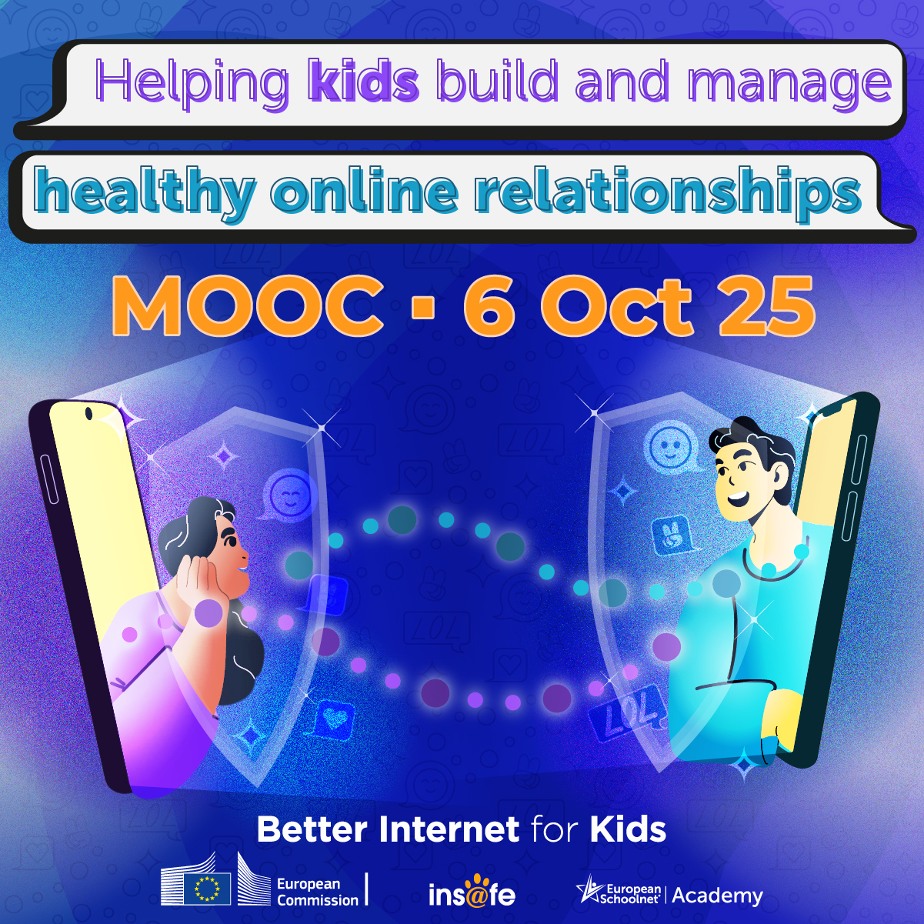
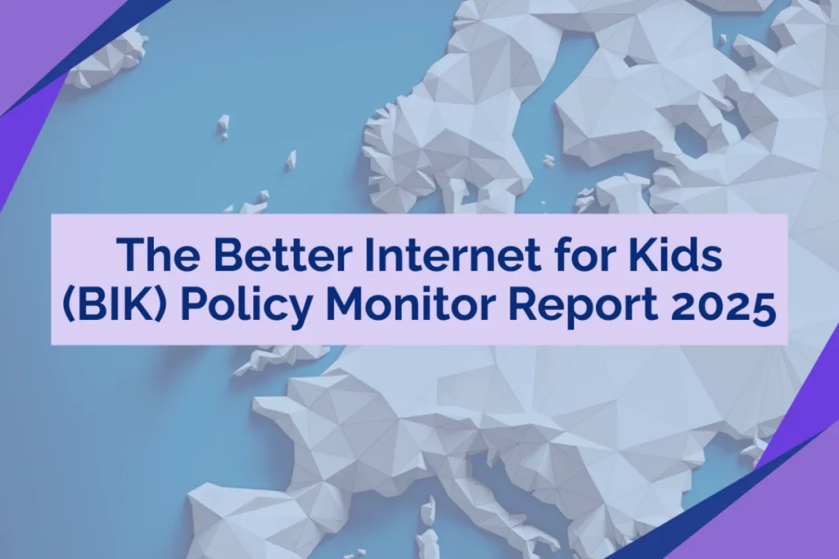
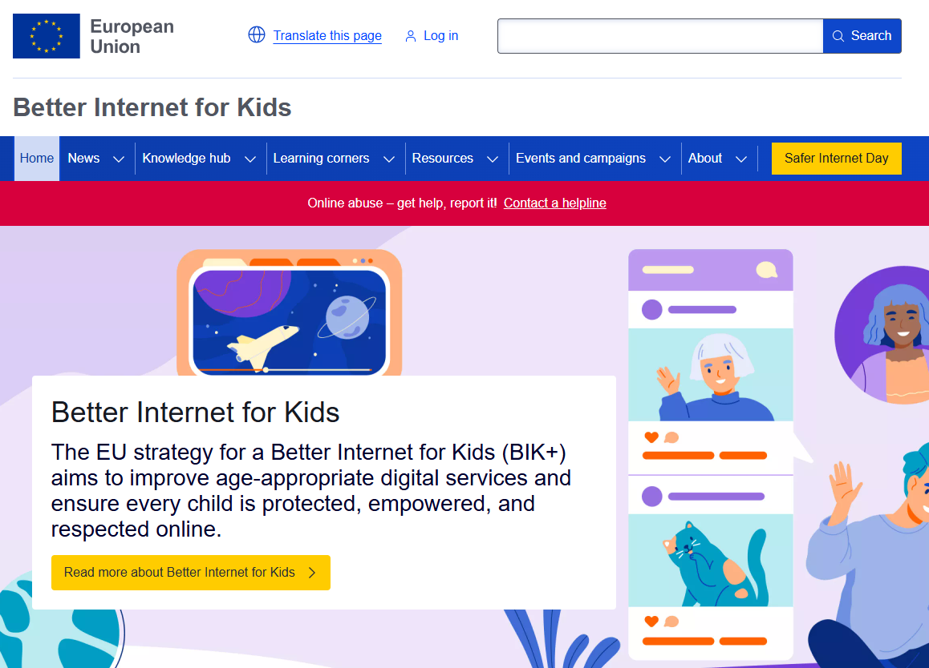
European cooperation
Participation in Insafe network
(working groups, training seminars)
Materials and articles
Betterinternetforkids.eu portal
Evaluation of the BIK plus strategy
Information for BIK Policy Map
14

Slide 15

Child Helpline 116111 (Lasteabi)
Service provider: Social Insurance Board
Available 24/7, free of charge
Counselling via:
Phone: 116111
Chat / Video counselling: www.lasteabi.ee
E-mail: info@lasteabi.ee
Counselling in Estonian, Russian, English
Awareness raising activities:
Workshops with children
Workshops with specialists
Social media campaigns
Follow us:
Facebook: facebook.com/lasteabi
Instagram: instagram.com/lasteabi

Slide 16

Helpline
Children’s Helpline – Key Statistics:
2024: 18,690 contacts
Jan–Sept 2025: 15,431 contacts
Approx. 20% of contacts are from children
1.8% of all contacts relate to Internet and digital device issues
Awareness-raising activities: more than 30 sessions reaching nearly 1,100 children
Main Online-Related Issues:
Cyberbullying
Data privacy violations (misuse of personal/private information)
Excessive use of digital devices
Exposure to harmful content
Non-consensual sharing of sexual images or texts
Online sexual coercion and extortion of children
16

Slide 17
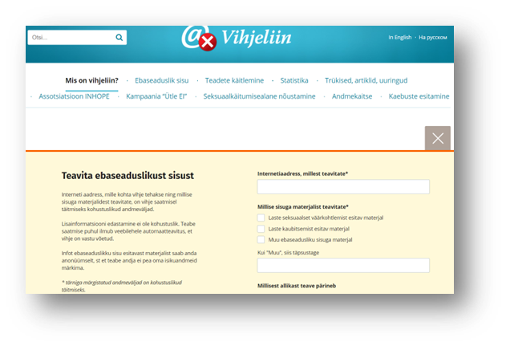
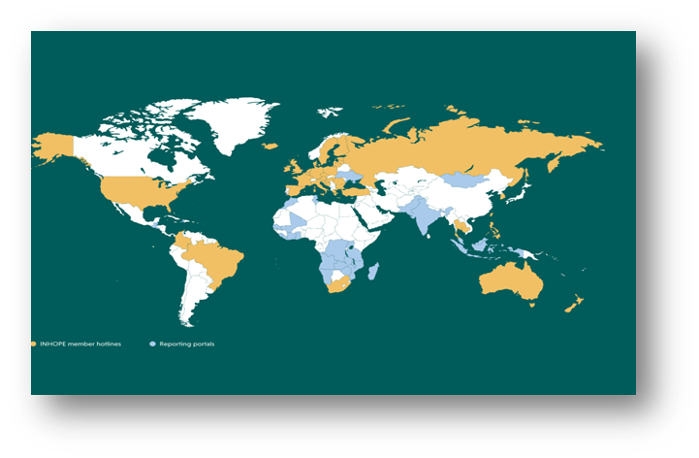
Hotline
The aim of the Estonian Hotline - Vihjeliin is to
tackle against the spread of child sexual abuse
material on the Internet.
The Hotline is a web-based service
https://vihjeliin/targalt internetis.ee to receive
reports from public on child sexual abuse material
on the Internet.
National cooperation - direct partner Estonian Police and Border Guard Board.
Cooperation agreement 2011, updated 2017.
European and international cooperation via INHOPE.
ICCAM to receive reports and to insert reports
Statistics:
in 2023 1612 reports
in 2024 791 reports
during 9 months of 2025 474 reports
17

Slide 18
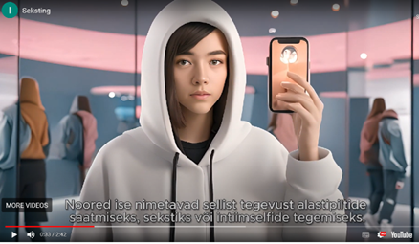


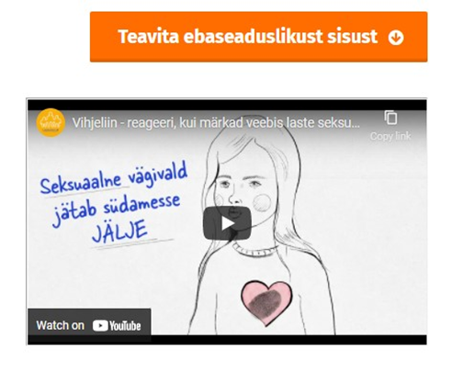
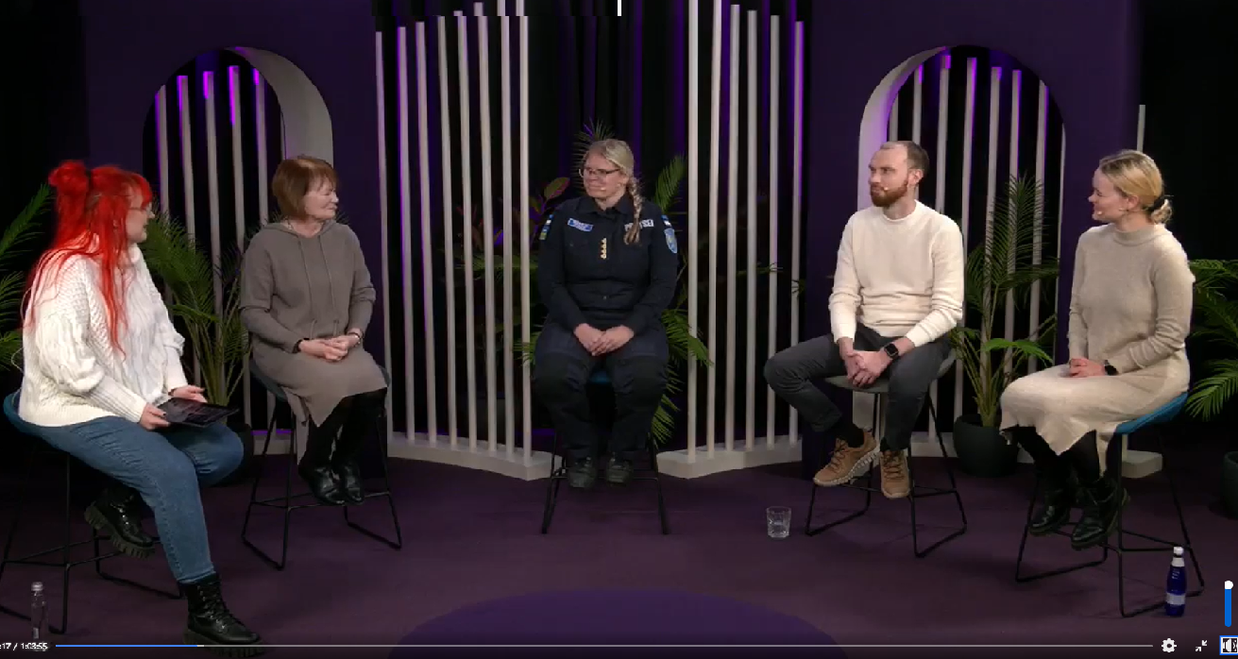

Hotline
Awareness raising of the Estonian Hotline
18

Slide 19
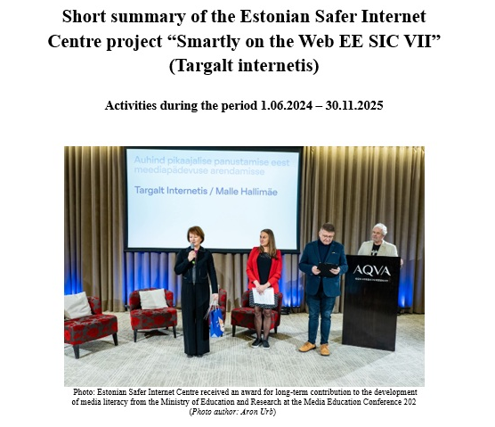
Estonian Safer Internet Center Report (Jun 2024 – Nov 2025)
Available: https://www.targaltinternetis.ee/en/news/2026/02/estonian-safer-internet-center-report-jun-2024-nov-2025-summary-in-english/

Slide 20
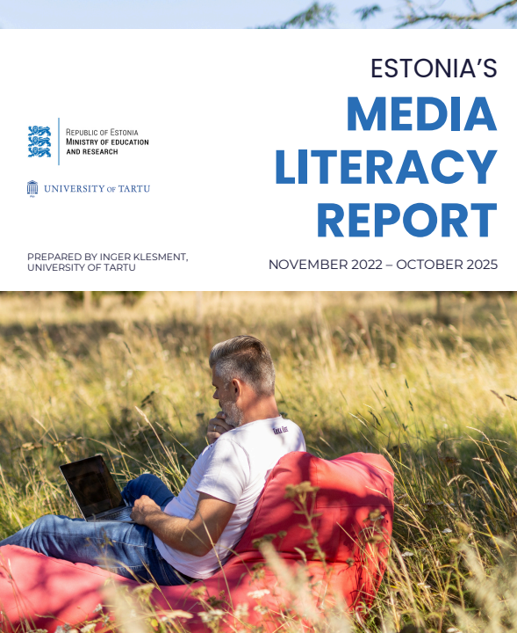
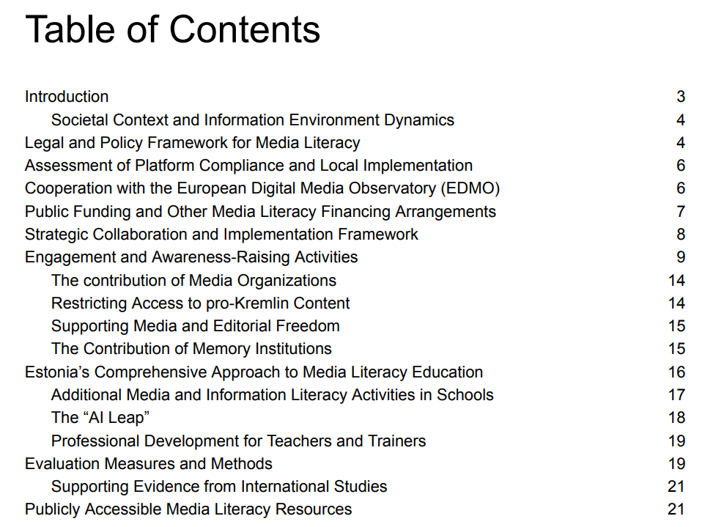
Estonia´s Media Literacy Report
https://www.targaltinternetis.ee/en/news/2026/02/estonia-s-media-literacy-report-nov-2022-october-2025/

Slide 21
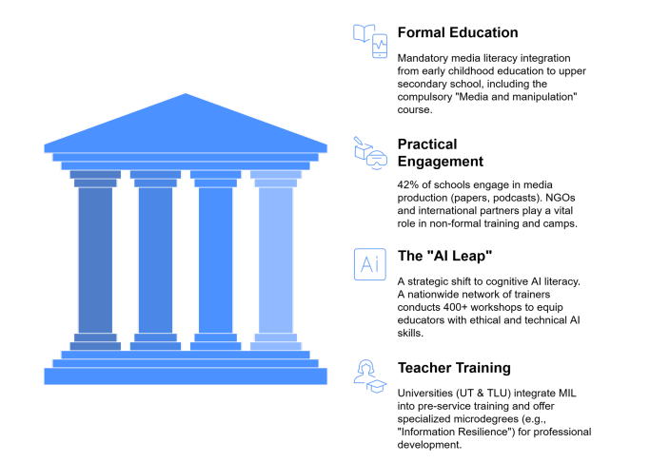
The four pillars of the Estonian media education ecosystem

Slide 22
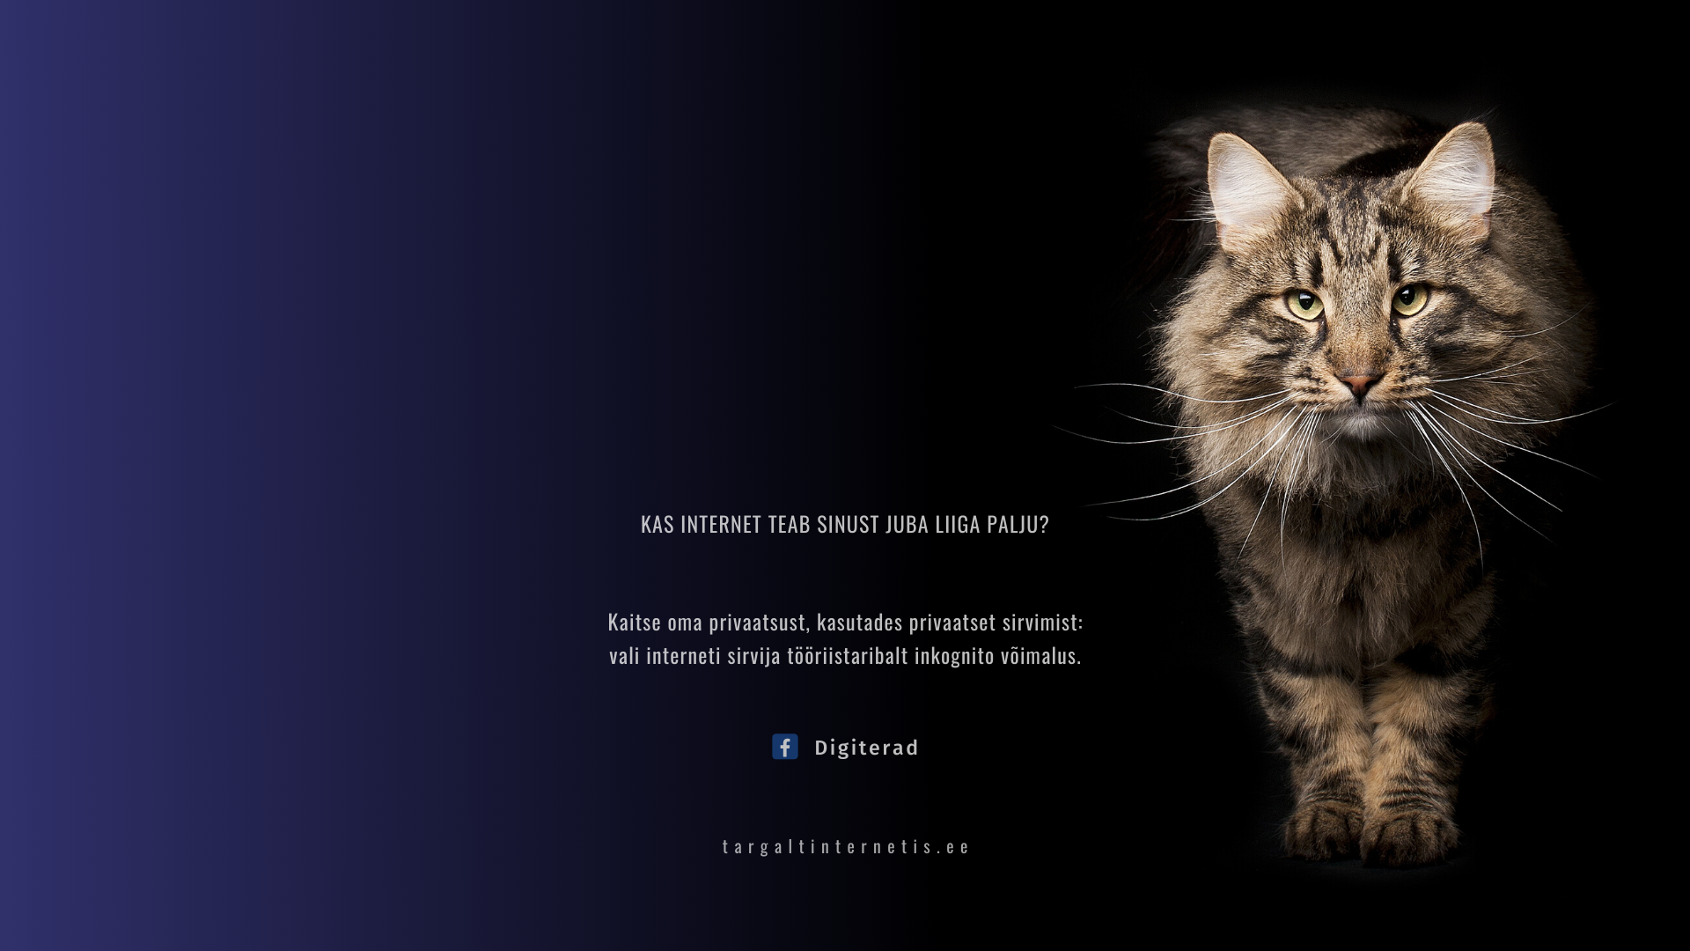
Thank you!
www.targaltinternetis.ee
Thank you!

