Slide 1
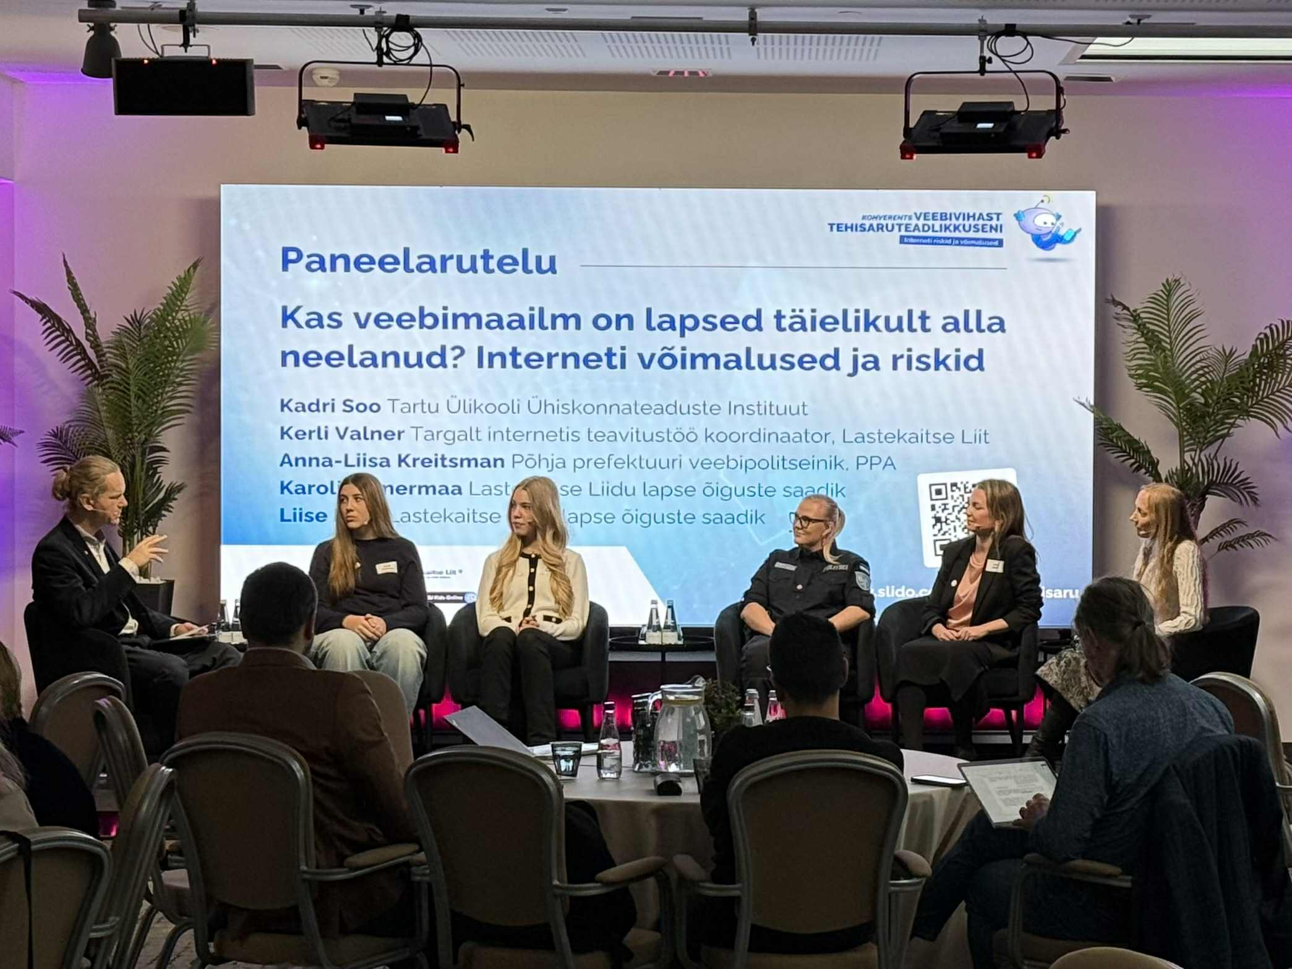




2026 Safer Internet Day conference: Presenting preliminary results of the EU Kids Online Estonia 2025 study
Kerli Valner
Awareness Raising Coordinator
Estonian Union for Child Welfare
16.04.2026, Latvia

Slide 2
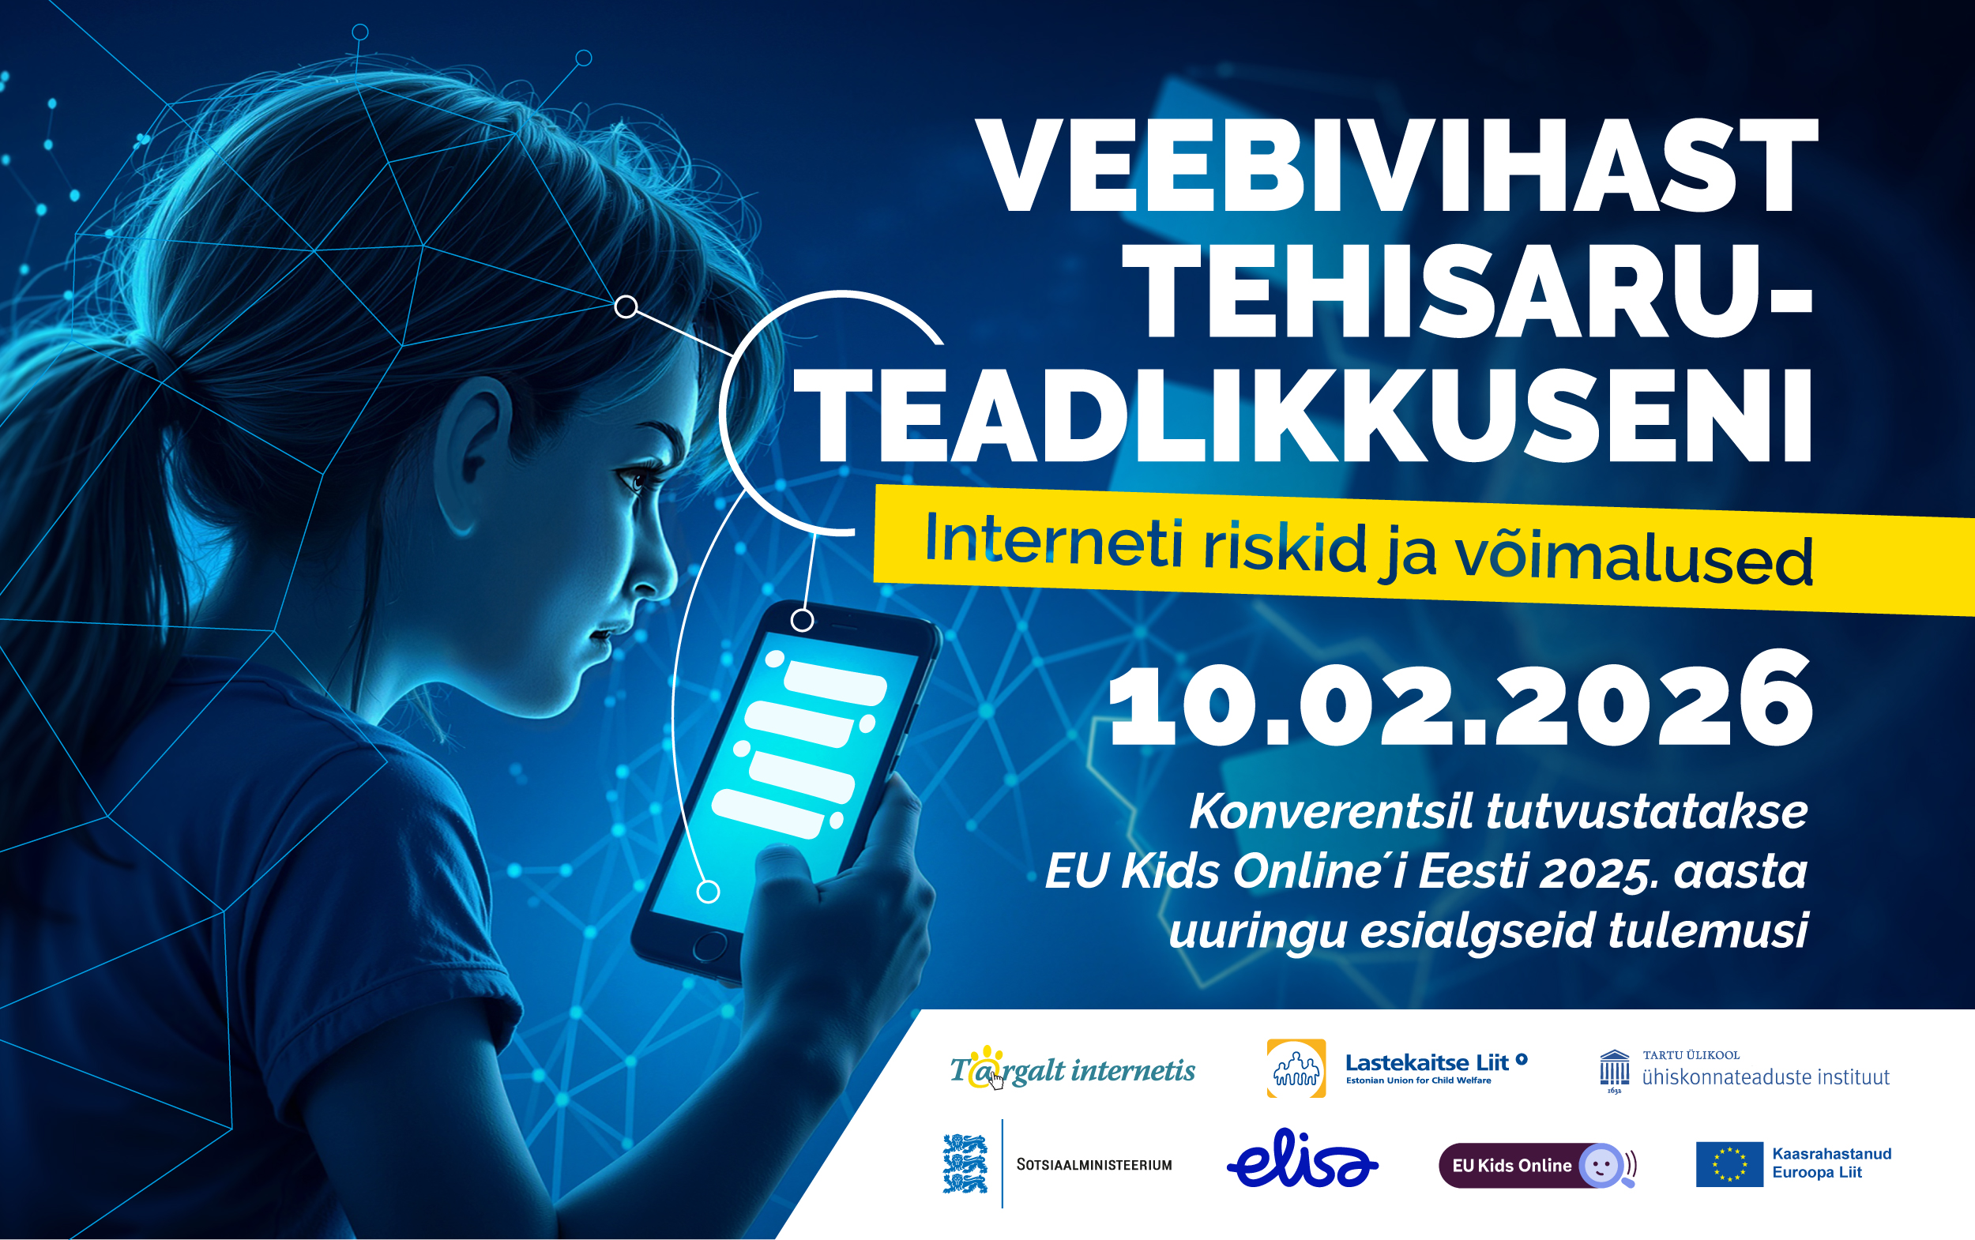
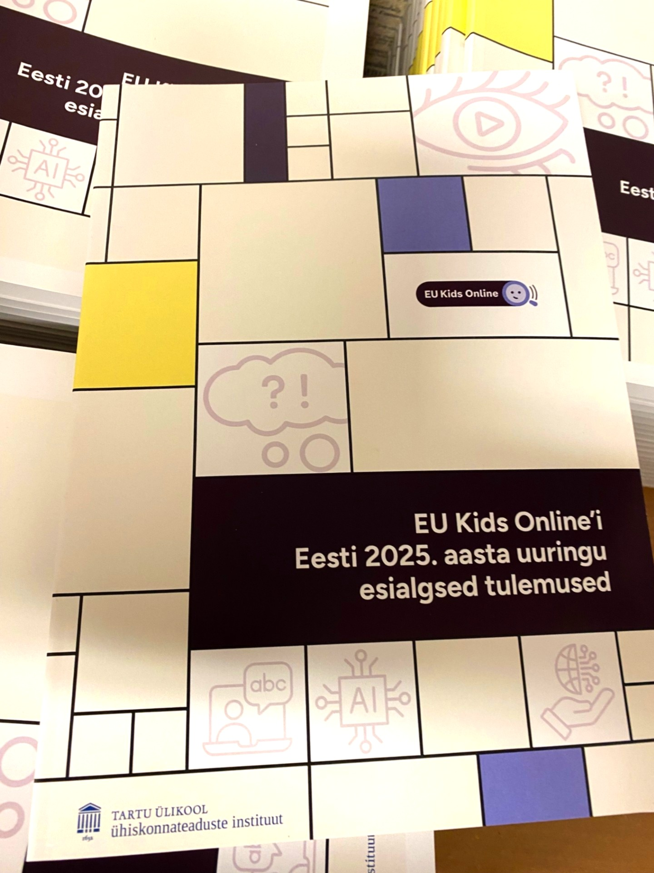
Safer Internet Day 2026
Conference “From Online Hate to an AI awareness. Opportunities and Risks Online” in Tallinn
Preliminary results of EU Kids Online Estonian research 2025 were published.
Results were presented by research team of University of Tartu and discussed with different stakeholders and young people.
Notes:
In 2019 we organised a conferenceto present the EU Kids Online Estonian research results and now 7 years later we organised a conference …

Slide 3
Preliminary results of the
EU Kids Online Estonia 2025 study
The study focuses on Estonian pupils’ use of digital technologies and the internet, digital literacy, online risks, and parental mediation of internet use.
In addition, new topics such as young people’s mental wellbeing and health, the use of artificial intelligence, and attitudes toward new technological solutions are included.
Quantitative study: 2474 young people aged 9-16 answered online questionnaire.
Qualitative study: sixteen young people aged 13–17 were interviewed.

Slide 4
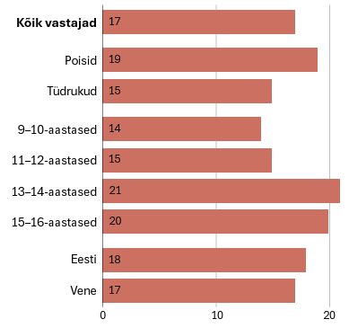
Some findings
In 2025, approximately 98% of 9–16-year-olds used the internet every day, either via a mobile/smartphone, a desktop or laptop computer.
In comparing 2018 and 2025, pupils use the internet for entertainment to a similar extent as before but use it more than previously for schoolwork.
A comparison of the 2018 and 2025 study results shows that several online risks have become more frequent. There has been no notable change in experiences of bullying, but receiving sexually explicit messages, seeing harmful online content, and excessive internet use have increased among pupils.
Experiences of cyberbullying,
in past 12 months
Notes:
This may be due to the wider use of web applications both at school and at home, online learning habits formed during the COVID-19 pandemic, and the spread of AI use.
The older the child, the more they have been exposed to online risks. Receiving sexually explicit messages, experiencing cyberbullying, and the risk of excessive internet use increase sharply in the 13–16 age group.

Slide 5

Mental wellbeing and its links with internet use
Children’s and young people’s mental wellbeing is supported by
- trusting relationships with parents (including parents’ active mediation of their children’s internet use) and
- greater autonomy in making versatile use of the opportunities offered by the internet (including fewer parental restrictions).
Experiences of (cyber)bullying and exposure to harmful online content reduce children’s and young people’s mental wellbeing.

Slide 6
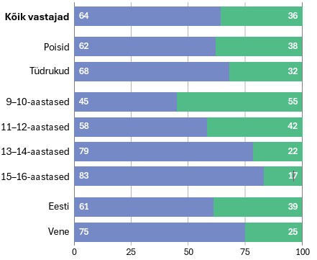
AI is most often used to summarise longer texts or obtain explanations, to write an essay or story needed for schoolwork, and to receive various recommendations (what to do, listen to, watch, or buy).
The interviews showed that young people mostly use AI in Estonian, mainly free applications.
Interviews revealed that some young people use AI as a sort of substitute teacher — for instance, asking it to explain topics they didn't understand in class or to catch up on material they missed.
Use of AI (in past month)
Notes:
So far, AI in Estonia has been mostly discussed in the context of schoolwork — whether and how it should be used in completing assignments. However, the new study reveals that young people's relationship with AI is far more diverse and complex. One of the most striking findings is the emergence of so-called AI companions — chatbots that young people interact with as friends, confidants or even romantic partners.

Slide 7

Potential risks
The most commonly reported issue was encountering incorrect or so-called hallucinated answers, which they later discovered were false after checking elsewhere.
To some extent, young people were also aware of privacy risks, but these were not considered especially significant.
There was far less awareness of broader issues such as environmental impact, bias, authorship or ethical considerations.
Notes:
So far, AI in Estonia has been mostly discussed in the context of schoolwork — whether and how it should be used in completing assignments. However, the new study reveals that young people's relationship with AI is far more diverse and complex. One of the most striking findings is the emergence of so-called AI companions — chatbots that young people interact with as friends, confidants or even romantic partners.
..which I will focus more on the slides.

Slide 8
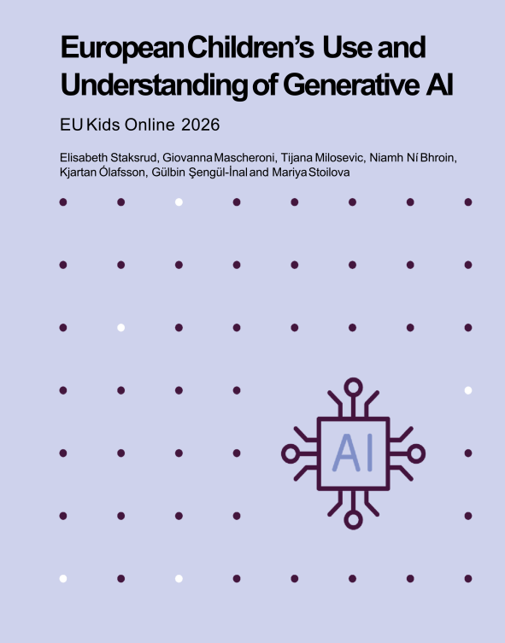
The report draws on comparative data from
20 European countries:
Austria, Belgium, Croatia, the Czech Republic, Estonia, Finland, Germany, Ireland, Italy, Latvia, Luxembourg, Malta, Norway, Poland, Portugal, Serbia, Slovakia, Spain, Switzerland, and the United Kingdom.
Data from the EU Kids Online survey with 25,592 children aged 9 to 16 in 17 countries and additional qualitative interviews with 244 children aged 13 to 17 years in 15 countries.
Notes:
The main aim of this report is to map children’s access to, use of and experiences with GenAI across Europe

Slide 9
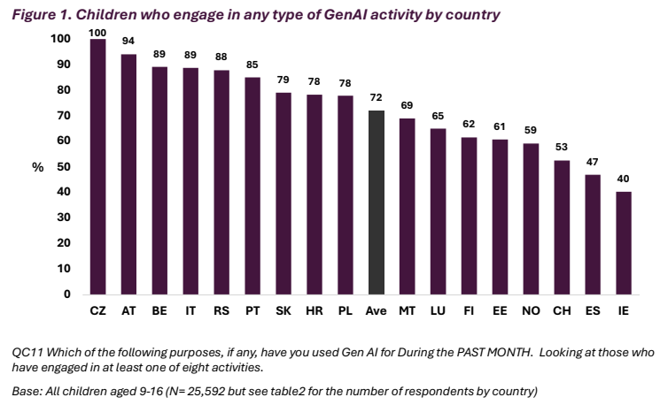
Notes:
72% of children are AI users, who reported using AI in last month.

Slide 10
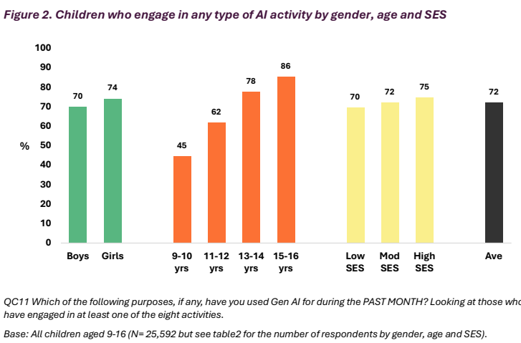
Notes:
Gender differences are small.
AI engagement increases as the children grow older.
Small difference in terms of socio-economic status.

Slide 11
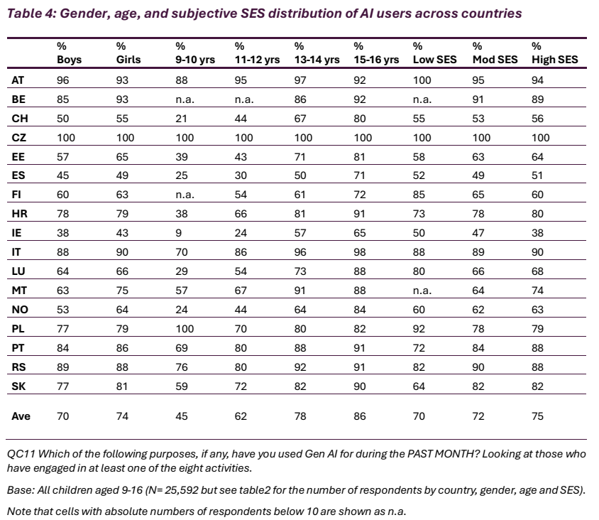
Notes:
Here you can have a closer look by country.

Slide 12
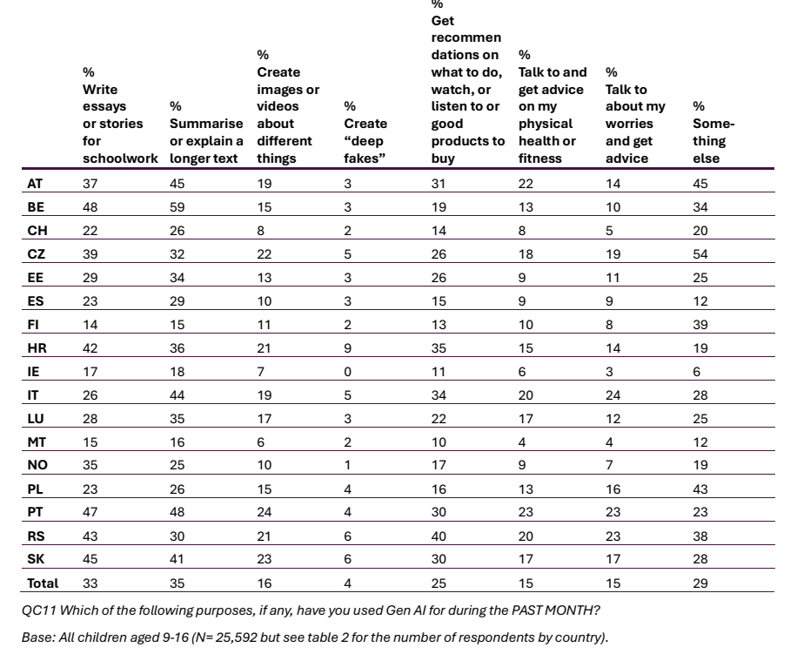
Notes:
School related uses are most common.
Practical uses are also widespread.
Deepfake creating is rare.
Around 15% report on asking advice from AI.

Slide 13
Deepfakes
In the qualitative interviews, children were mostly aware of problems with deepfakes - can be used for manipulative purposes, including disinformation and the unintentional spread of misinformation.
Several children said they had seen deepfakes on social media.
Fewer children, however, talked about having witnessed instances of cyberbullying where deepfakes were leveraged to bully someone.
While children reported awareness that GenAI could be used for such malicious purposes, for the most part, they had not experienced this problem.

Slide 14
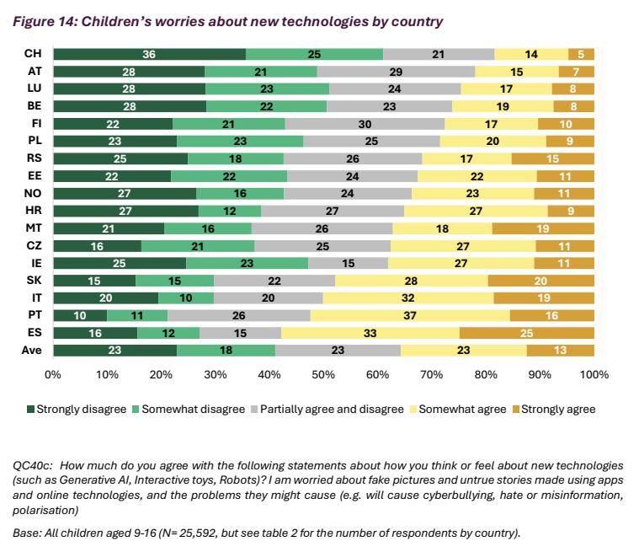
Notes:
Children worries about the fake pictures and untrue stories using AI apps, or it can cause cyberbullying and hate..
In Spain and Portugal children are most likely to agree, that these are problems related to technology.

Slide 15
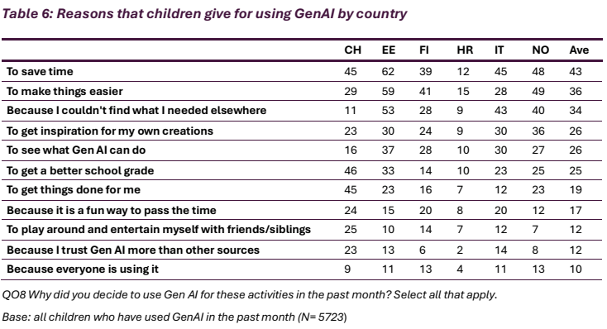
Notes:
So why do children use AI? Data from 6 countries.
Here is motivations of use – children use it mostly to save time…

Slide 16
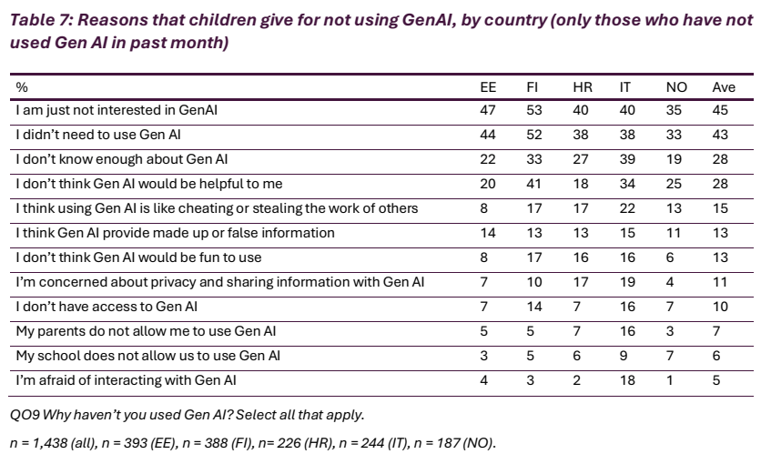
Notes:
Children’s non-use of GenAI is most often linked to limited interest, lack of perceived relevance, or a sense that GenAI is simply not needed for everyday tasks. Another reason for non-use includes lack of knowledge about AI.
Among interviewees who had at least occasionally used AI, the main reasons for non-use, or limiting their use, are fear of deskilling and disempowerment, lack of trust in the reliability of outputs and ethical reasons (such as the sense that they are cheating).

Slide 17
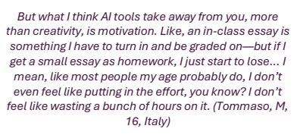

What they fear?
A fear expressed by children in many countries is that GenAI promotes deskilling, laziness or cognitive disempowerment, not only among children but also in adult populations.
Children sometimes expressed concerns that in the future, professionals, such as doctors, lawyers or architects, may lose their ability to do their jobs well due to an overreliance on GenAI.

Slide 18

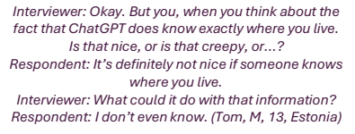
Concerns
Some children also reported specific concerns about privacy.
Many of them said they were aware that sharing private personal information with chatbots could be unsafe and that they were not clear as to how the data could be processed and shared further.
While some children are turning to GenAI for personal advice and chatting when bored, the majority continues to trust their friends, family and expert knowledge (doctors, scientists, textbooks) more.

Slide 19
Recommendations
1. Industry should design age-appropriate, safe and private tools that respect children’s rights.
2. National governments and transnational institutions like the EU should implement regulations to guarantee that companies comply with children’s rights by design principles.
3. Teachers should provide clear rules around the use of GenAI in schoolwork and guide them through positive uses, supporting their acquisition of GenAI literacies.
4. Parents should accompany their children in the use of GenAI: although they may fear they lack the required skills, they can help reinforce their critical AI literacies, including checking the reliability of outputs or assessing the privacy of services.
5. The media have the responsibility to portray GenAI for what it actually does, as well as what it promises to deliver.

Slide 20
References
Kalmus, V., Opermann, S., Kurvits, R. (toim) (2026). EU Kids Online´I 2025. aasta uuringu esialgsed tulemused. Tartu: Tartu Ülikool, ühiskonnateaduste instituut.
Staksrud, E., Mascheroni, G., Milosevic, T., Ní Bhroin, N., Ólafsson, K., Şengül-İnal, G., & Stoilova, M. (2026). European children’s use and understanding of Generative AI. EU Kids Online V.

Slide 21
Thank you!
Kerli Valner
Kerli.Valner@lastekaitseliit.ee

